Slide 1

Arduino-Based Home Automation
Luis Guevara
Luis Guevara

Slide 2
Overview
Build a website that serves as an interface for a home automation setup
Utilizes an Arduino UNO and an Arduino Ethernet shield as a web server
The owner of the home automation set up is able to navigate through the website and able to control lights.

Slide 3
Why Arduino UNO?
Ease of use
Enough functionality for my purpose
Inexpensive

Slide 4
Code
Two Pieces of code; Arduino sketch and HTML page
Sketch contains code to set up I/O, Arduino as server
HTML file is loaded onto an SD card within the Ethernet Shield
HTML page is the visual interface home owner uses

Slide 5
Arduino Sketch
Ethernet libraries included
I/O pins initialized
LAN IP, gateway IP, subnet mask was given to create the server
Buffer created to get HTTP requests

Slide 6
Arduino Sketch
Specified LED’s as outputs
Error checked when initializing the SD card
After error checking, initialize Ethernet services

Slide 7
AJAX (Asynchronous JavaScript and XML)
Used to update a web page without reloading the page
Request/Receive data from a server after the page has loaded
Can send data to a server in the background
How did I utilize it here?

Slide 8
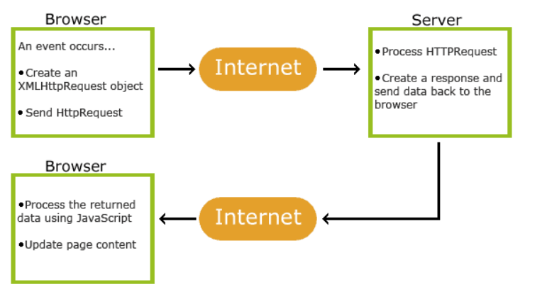
How it works?
Notes:
1. An event occurs in a web page (the page is loaded, a button is clicked)
2. An XMLHttpRequest object is created by JavaScript
3. The XMLHttpRequest object sends a request to a web server
4. The server processes the request
5. The server sends a response back to the web page
6. The response is read by JavaScript
7. Proper action (like page update) is performed by JavaScript

Slide 9
Application
Server continuously listen to clients
Check to see if client is trying to connect (web browser loading page from Arduino web server)
If so, JavaScript on webpage sends an AJAX request for data from the Arduino every second

Slide 10
Application
Arduino then responds to every AJAX request by sending an XML file back to the web browser
XML file contains the states of the LED’s (on/off)
When LED button is clicked on webpage, JavaScript will then send an instruction to turn it on/off with the next AJAX request

Slide 11
Changes?

Slide 12
Security
Security wasn’t a priority
Implemented .htaccess password protection, but hardware was slooooow
Used a specialized library for Arduino called MiniApache – not that great ☹
Later realized that I could keep it only on the network, less complicated for my use

Slide 13
CSS
Used CSS on page to make interface look nicer
Larger buttons, stressed on ease-of-use
Mobile friendly

Slide 14
Another problem - lag
Lag between when the checkbox was pressed and when the Arduino would receive the change
Cleaned up code, condensed snippets into functions that would be called
Cleaning up code reduced resources used on Arduino

Slide 15
Do it over again?
Arduino UNO’s hardware wasn’t the best choice
Easy to use, but for the features I wanted, I need something more powerful
Simplify my HTML code with Jquery – next on list

Slide 16
Demo
https://www.youtube.com/watch?v=40YfE08_QM4

